Slide 1
Parking Guidance System Solution

Slide 2
About Us
Mr.Nguyễn Đức Lợi
Supervisor
Trần Nguyễn Minh Trung
Firmware: System architecture & interface protocol
Software: Android Application
Bùi Phú Hiệp
Nguyễn Đỗ Phương Huy
Hardware: Design & Implement
Software: Web Server
Hardware: Implement
Testing: Design and Execute

Slide 3
Outline
Problem
Solution
How the System Works
Web Service
Hardware
Firmware & Software Implement
Advantages & Disadvantages
Future Plan
Demo

Slide 4
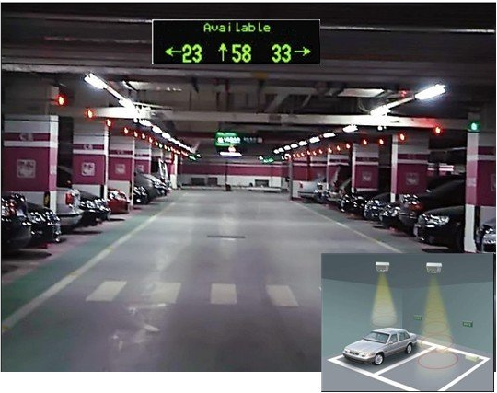

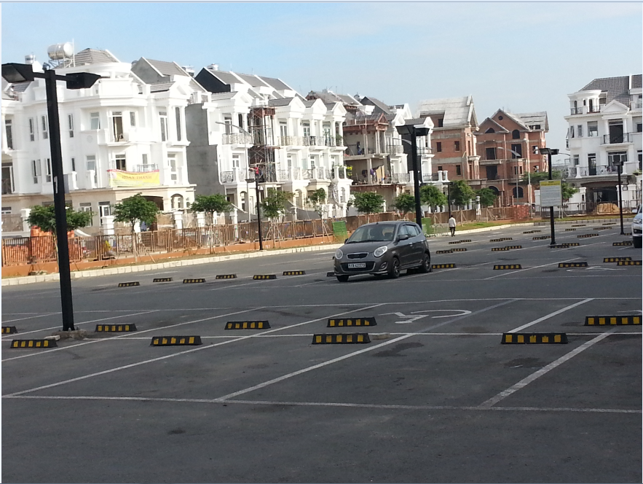
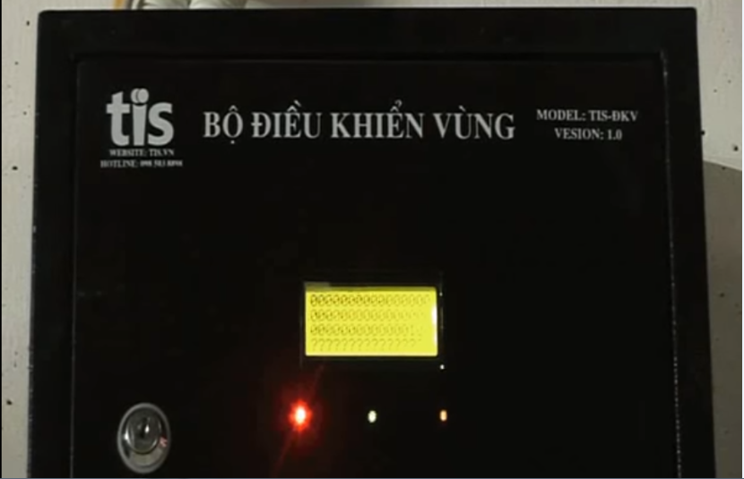
Problem

Slide 5
Problem
Limited number of monitored parking lots
Complicated planning of wired system
Incompatible with outdoor system
Limited information provided to drivers

Slide 6
Solution

Slide 7

How the system works

Slide 8

How the system works

Slide 9

How the system works

Slide 10

How the system works

Slide 11
How the system works
Collect Data

Slide 12
How the system works
Update Information

Slide 13

How the system works
Send data

Slide 14
How the system works
Receive command

Slide 15
How the system works
Update Status

Slide 16
How the system works

Slide 17
How the system works
Collect Data

Slide 18

How the system works
Get Information

Slide 19
How the system works
Issue a command

Slide 20
How the system works
Send Command

Slide 21
How the system works

Slide 22


Web Service
Database
Web server

Slide 23
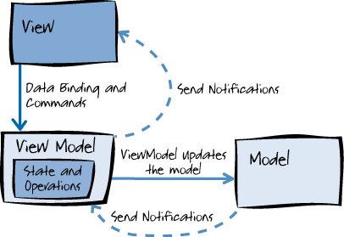
Web Service

Slide 24
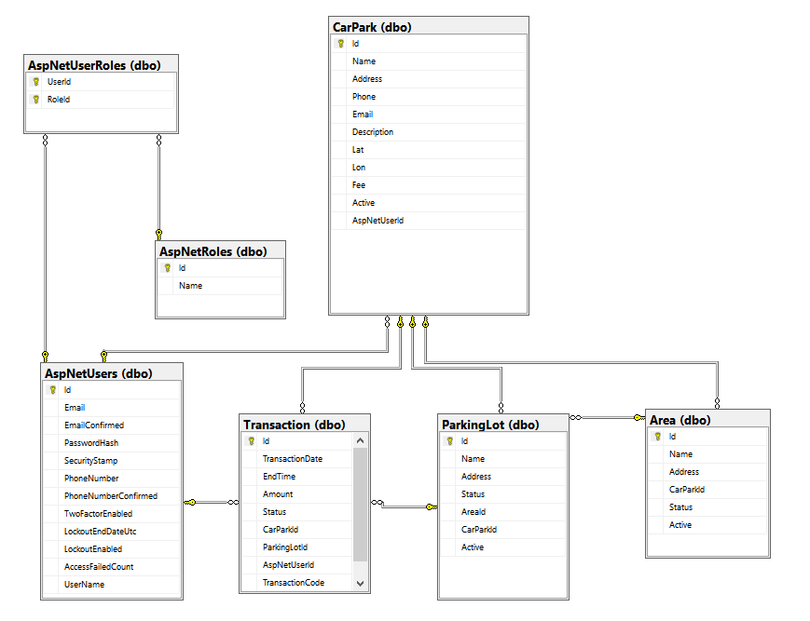
Web Service

Slide 25
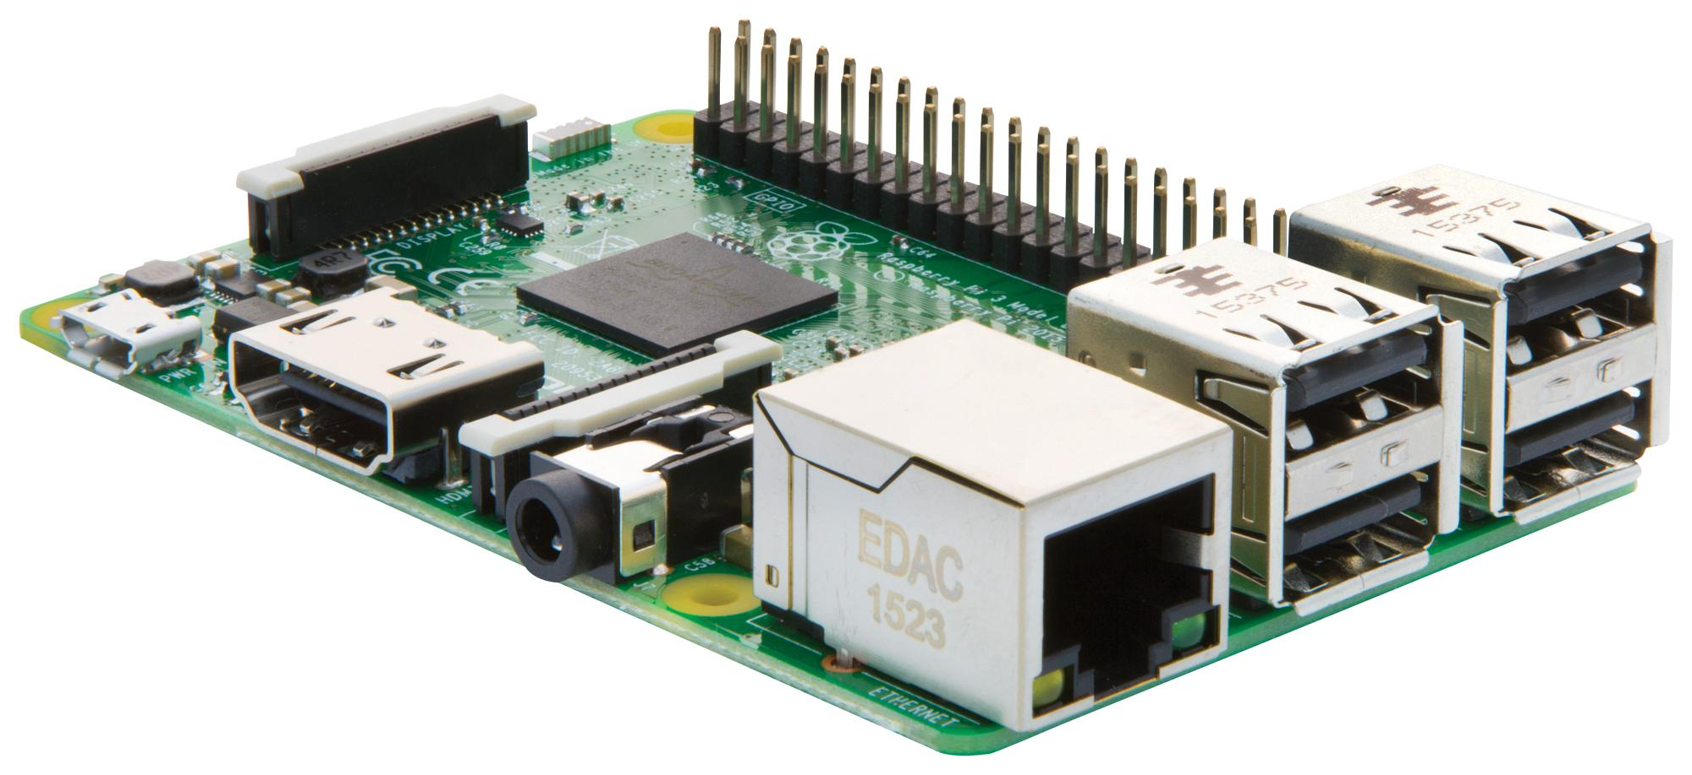
Hardware

Slide 26
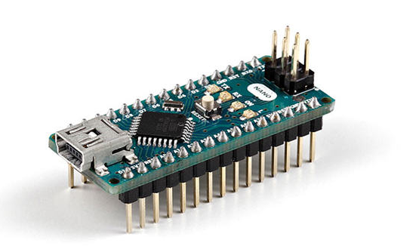
Hardware

Slide 27
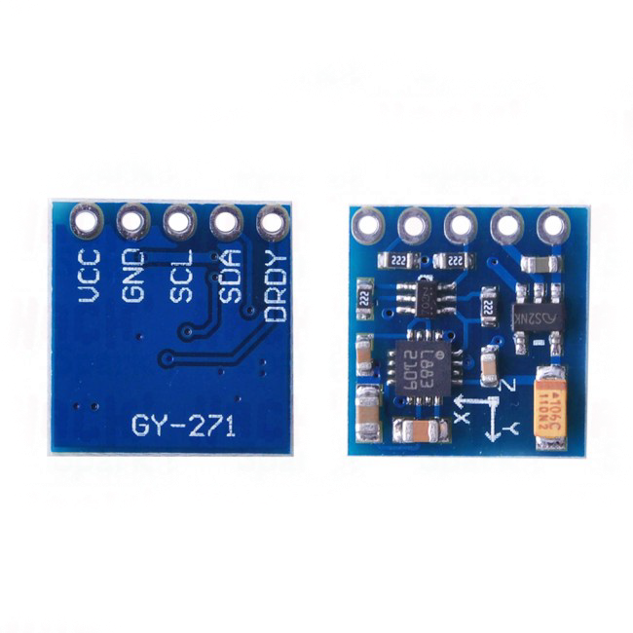
Hardware

Slide 28
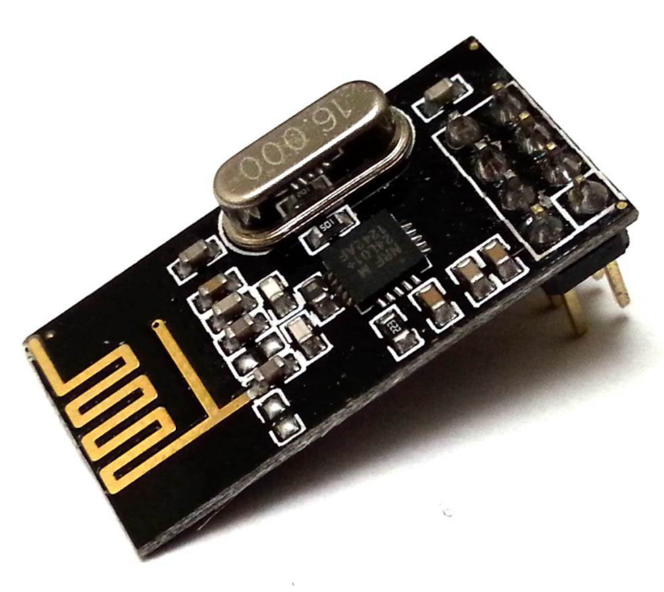
Hardware

Slide 29
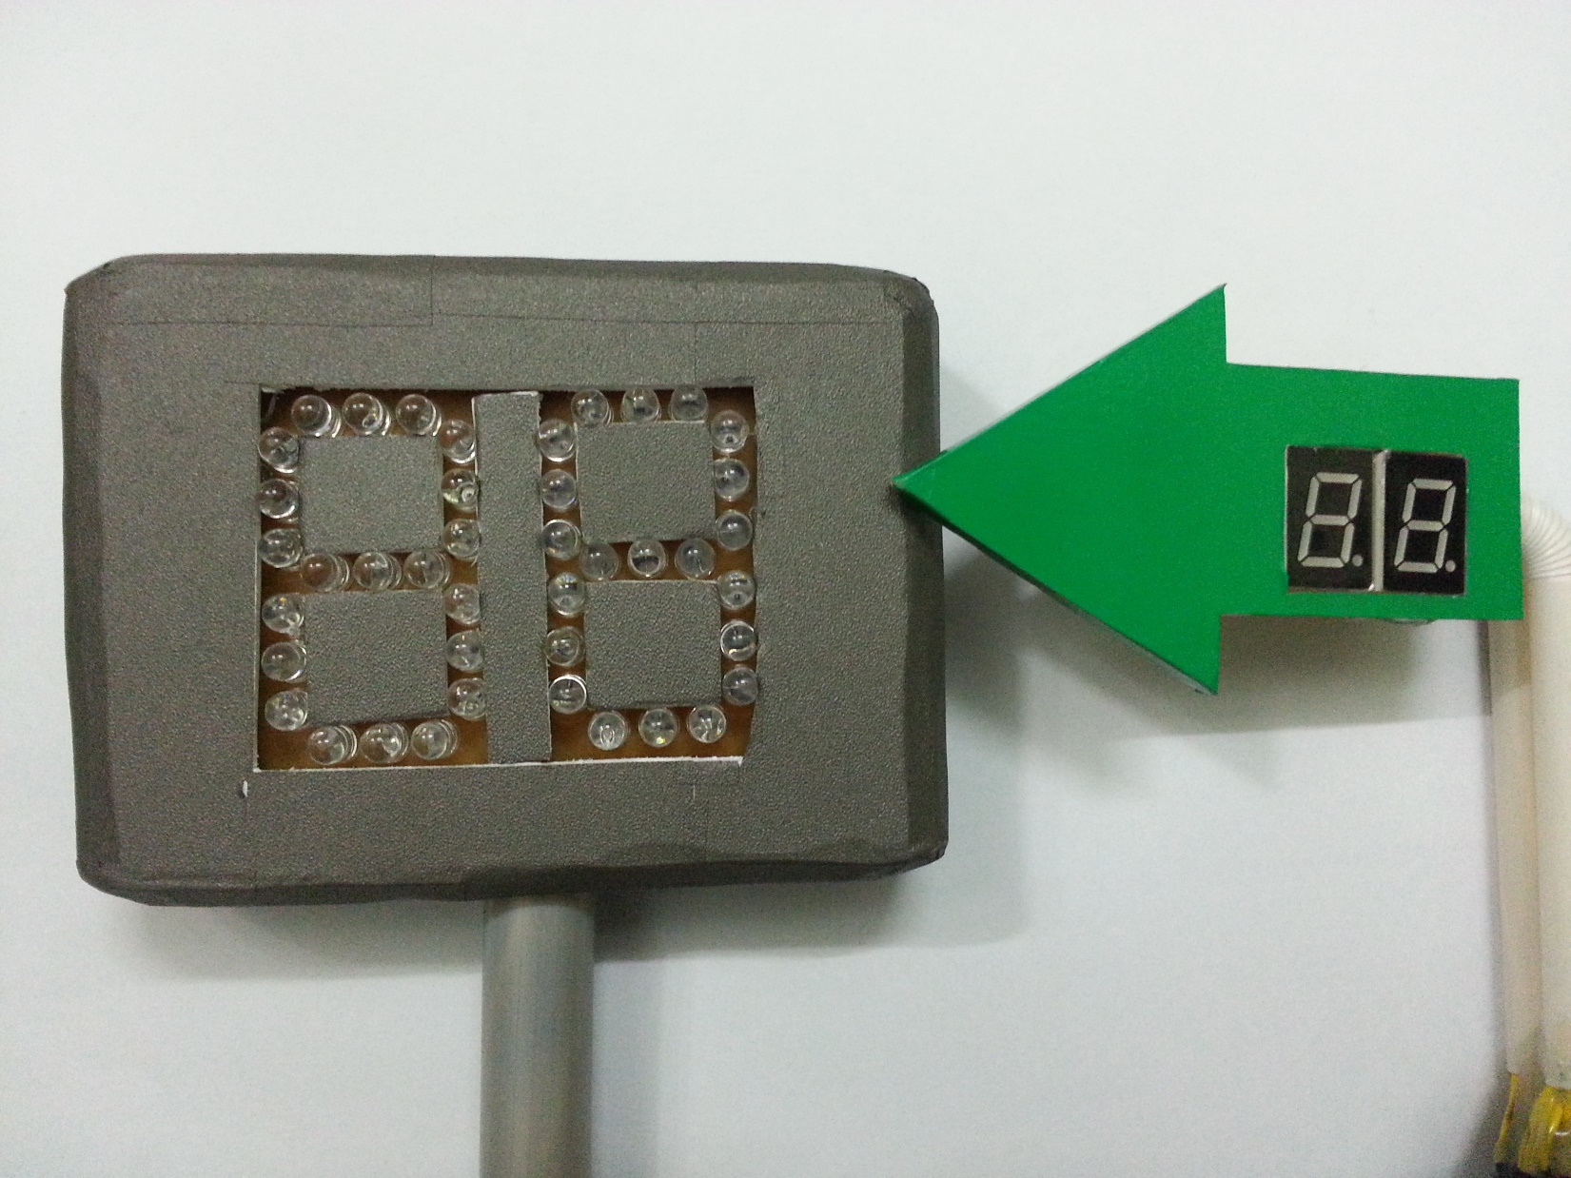
Hardware

Slide 30
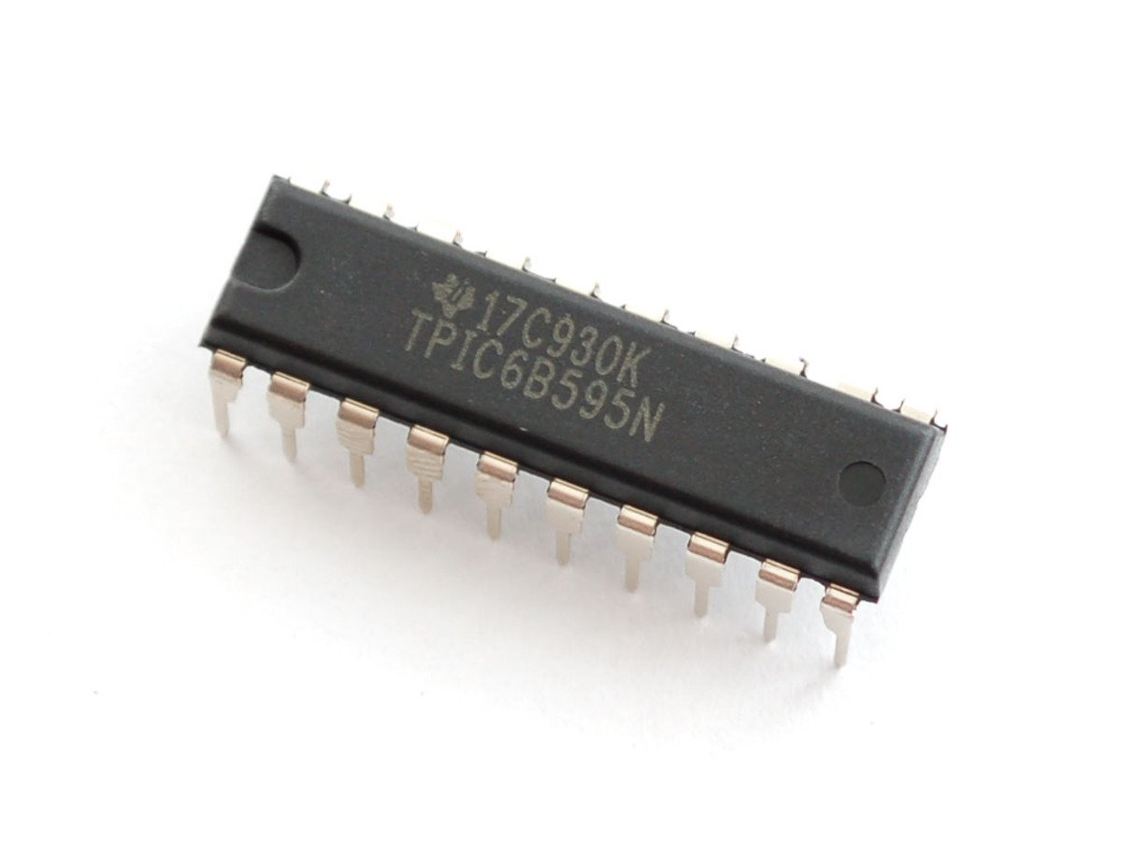
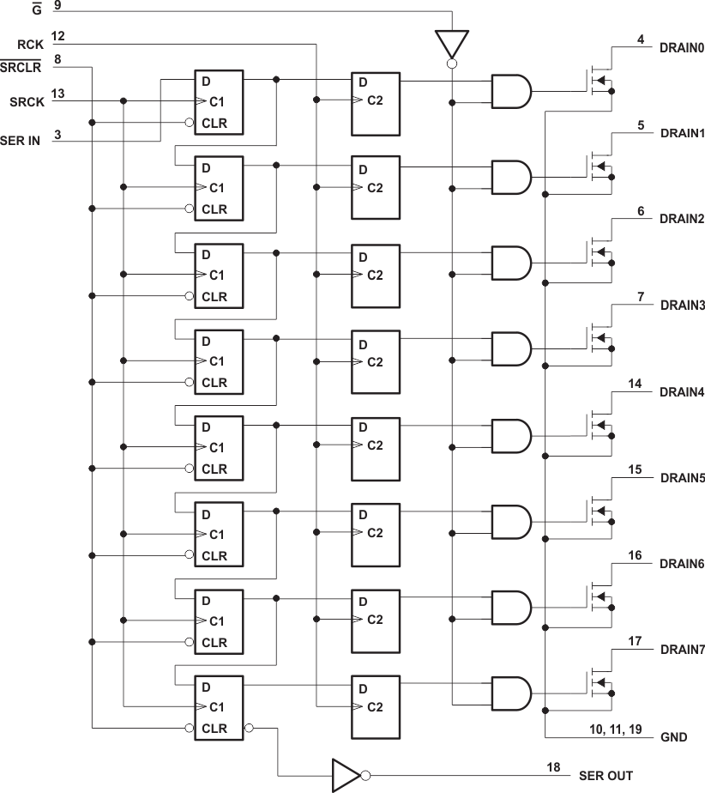
Hardware

Slide 31
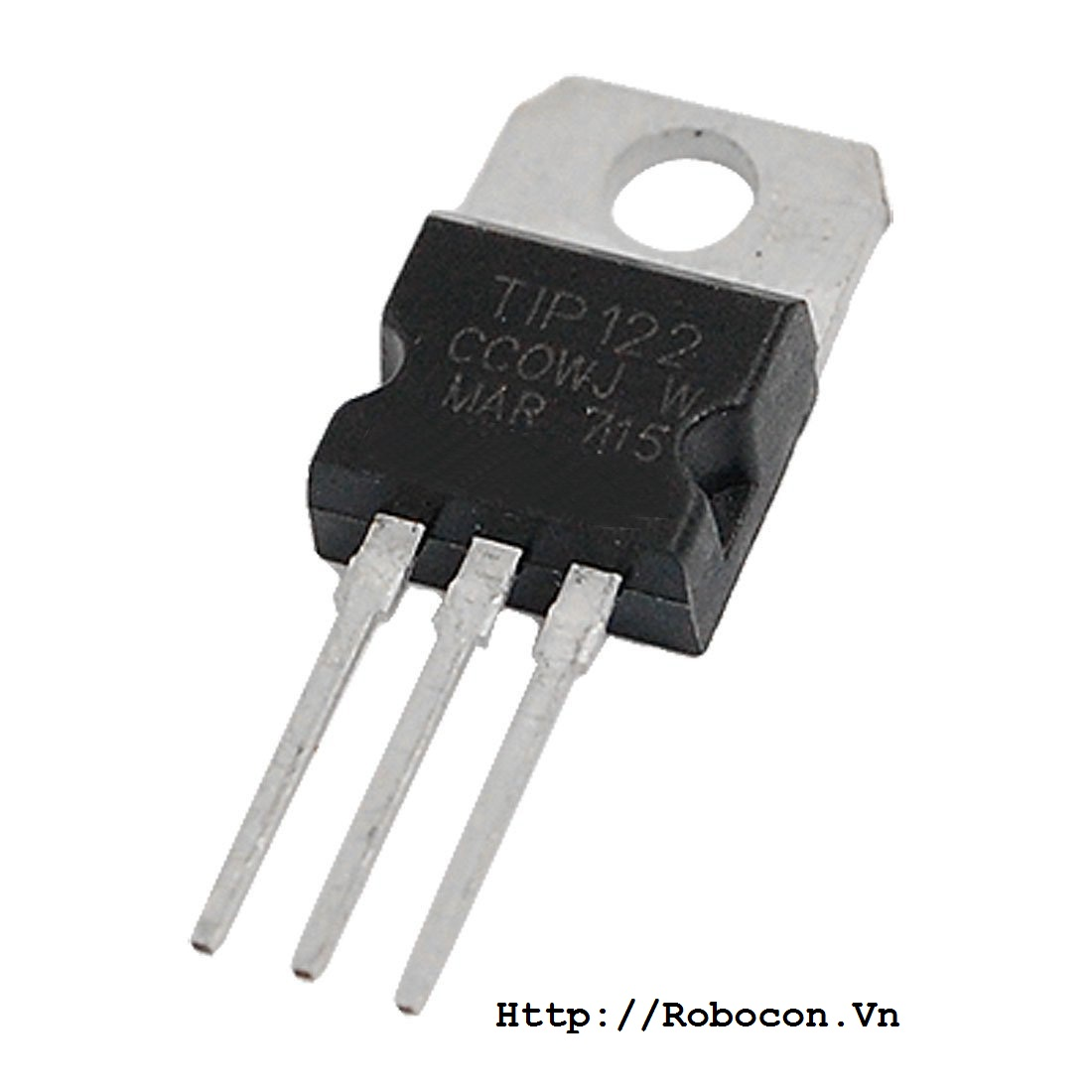
Hardware

Slide 32
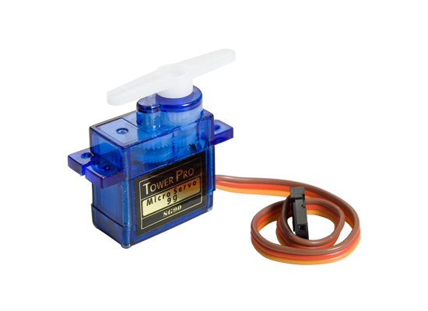
Hardware

Slide 33
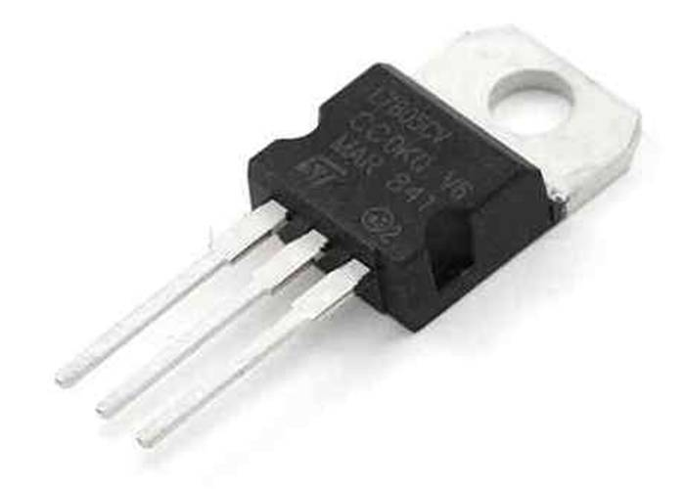
Hardware

Slide 34
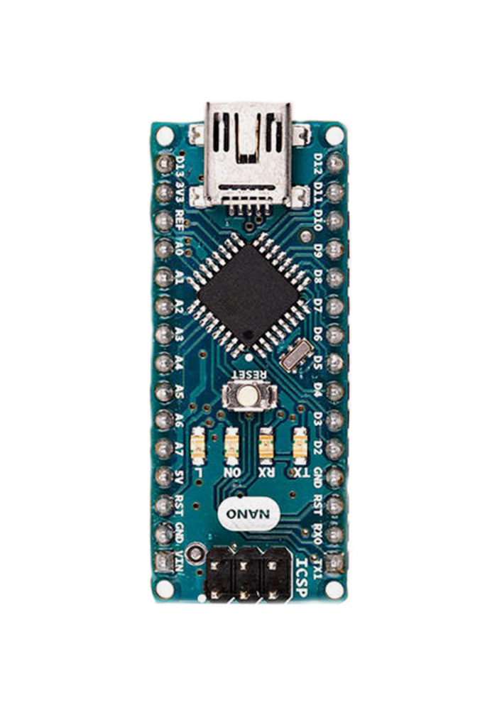

Implement Firmware
Lot Node
D13
D12
SPI
D11
RF24
CRC24
RFUtil
nRF24L01+
D8
D7

Slide 35
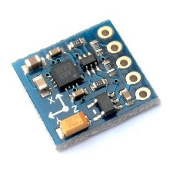
Implement Firmware
Lot Node
nRF24L01+
Wire
HMC5883L
HMC5883L
A4
A5
I²C

Slide 36
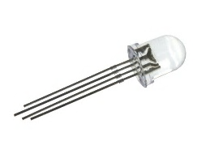
Implement Firmware
Lot Node
nRF24L01+
HMC5883L
D6
RGBLED
D5
LED RGB
D3
TIP122

Slide 37

Implement Firmware
Lot Node
nRF24L01+
HMC5883L
LED RGB
D4
Servo
Servo

Slide 38
Implement Firmware
Start

Slide 39
Implement Firmware
Start
Init components

Slide 40
Implement Firmware
Start
Init components
While(true)

Slide 41
Implement Firmware
Start
Init components
While(true)
Get magnetometer data and update status if necessary

Slide 42
Implement Firmware
Start
Init components
While(true)
Get magnetometer data and update status if necessary
Get RF payload and perform action if necessary

Slide 43
Implement Firmware
Start
Init components
While(true)
Get magnetometer data and update status if necessary
Get RF payload and perform action if necessary

Slide 44
Implement Firmware
Sign Node
D13
D12
SPI
D11
RF24
CRC24
RFUtil
nRF24L01+
D8
D7

Slide 45
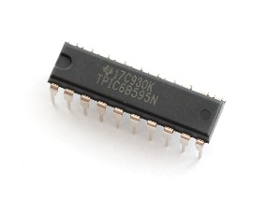
Implement Firmware
Sign Node
nRF24L01+
SEVEN_SEGMENT
TPIC6B595
D5
D4
D3
5V
GND

Slide 46
Implement Firmware
Start

Slide 47
Implement Firmware
Start
Init components

Slide 48
Implement Firmware
Start
Init components
While(true)
Get RF payload and perform action if necessary

Slide 49
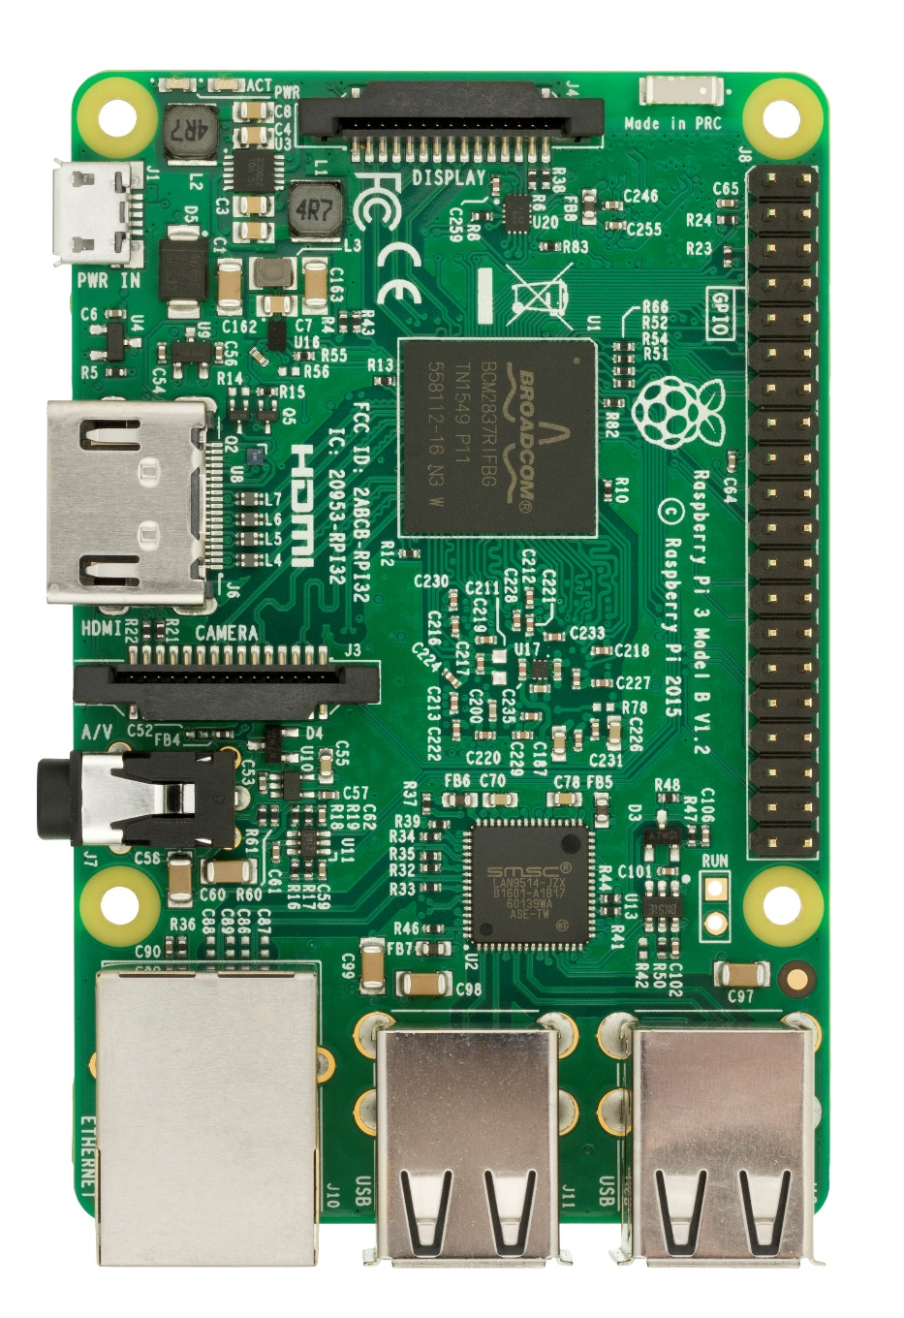
Implement Firmware
Sign Node
crc24
rf_util
Area
ParkingLot
SPI
nRF24L01+
BCM22
BCM8
3V3
MOSI
MISO
BCM11
GND

Slide 50
Implement Firmware
Sign Node
nRF24L01+
pubnub_meta
UserPackage
PubNub

Slide 51
Implement Firmware
Sign Node
nRF24L01+
PubNub
api_service
Api Server

Slide 52
Implement Firmware
Start

Slide 53
Implement Firmware
Start
Init component

Slide 54
Implement Firmware
Start
Init component
While(true)

Slide 55
Implement Firmware
Start
Init component
While(true)
If the request flag is false, set polling flag to true and start polling process

Slide 56
Implement Firmware
Start
Init component
While(true)
If the request flag is false, set polling flag to true and start polling process

Slide 57
Implement Firmware
Start
Init component
While(true)
While(true)
If the request flag is false, set polling flag to true and start polling process

Slide 58
Implement Firmware
Start
Init component
While(true)
While(true)
If the request flag is false, set polling flag to true and start polling process
Callback if receive request from Pubnub, set request flag to true, wait until the current polling is finished and start performing request

Slide 59
Implement Firmware
Start
Init component
While(true)
While(true)
If the request flag is false, set polling flag to true and start polling process
Callback if receive request from Pubnub, set request flag to true, wait until the current polling is finished and start performing request

Slide 60
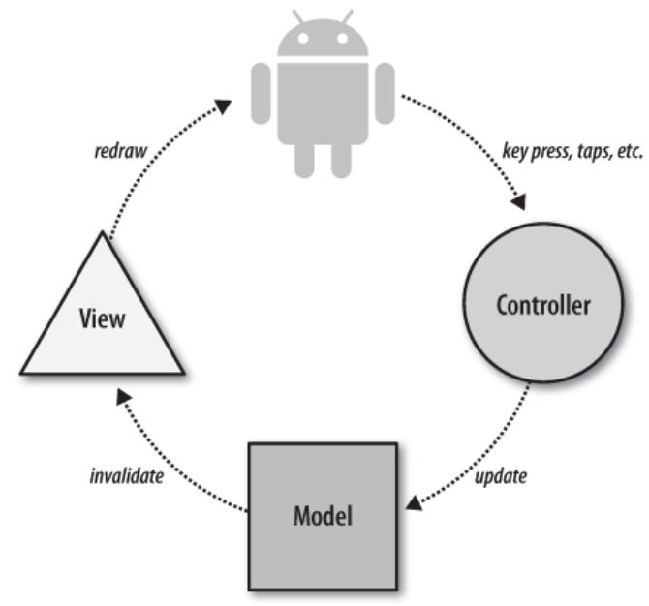
Implement Mobile

Slide 61
Implement Mobile
Activities
LoginActivity
UserActivity
ManagerActivity
TransactionActivity
…
Interfaces
Adapters
Networks
Helpers
Models

Slide 62
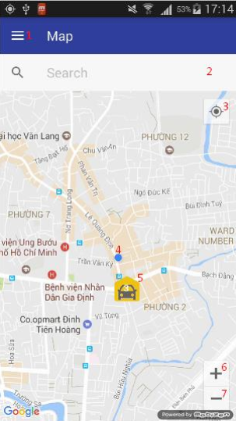
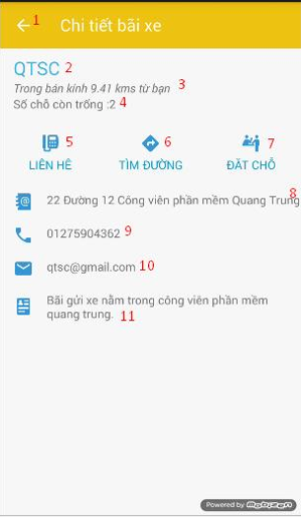
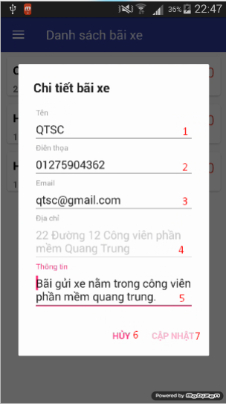
Implement Mobile

Slide 63
Advantage
Hardware:
Easily setup
Small devices so they were easy to maintain
Low cost

Slide 64
Advantage
Software:
Friendly mobile interface
Scalable cloud hosting

Slide 65
Disadvantage
Hardware:
Low simulation fidelity
High RFI in testing environment

Slide 66
Disadvantage
Software:
Simple algorithm, do not suitable for large car park
Only support android
Limited support for manager

Slide 67
Future Plan
Improve testing environment
Algorithm for hop, improve polling speed
Create app for multi-platform

Slide 68
Demo

